Slide 1
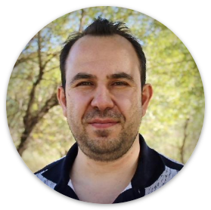


Multi-modal data integration using deep learning and applications in precision oncology
Dr. Bora Uyar
Computational Genomics Workshop
10-16 March 2025

Slide 2
Plan
Lectures + hands-on + HW + Quizzes
Follow Google Classroom for announcements
Helping each other: https://github.com/BIMSBbioinfo/compgen_course_2025_module3/discussions

Slide 3
The global cancer burden
10 Million
cancer-related deaths in 2020
arcas.ai
$80 Billion
direct medical costs per year just in the US
$2.7 Billion
Cost of developing a single cancer drug
Too many deaths, too expensive
https://www.cancer.gov/about-cancer/understanding/statistics
https://www.cancer.org/cancer/cancer-basics/economic-impact-of-cancer.html

Slide 4
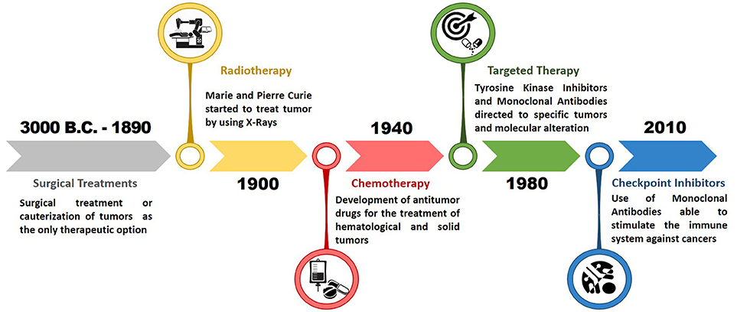

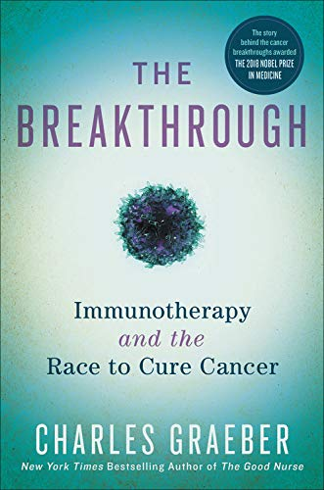
Falzone L., Front. Pharmacol., 13 November 2018 | Evolution of Cancer Pharmacological Treatments at the Turn of the Third Millennium
Notes:
The disease can be traced back to 3000 BC
Surgery, radiotherapy, chemotherapy, targeted therapies
Diagnosis/treatment decisions: BRCA example
panel/WES
What’s next?

Slide 5
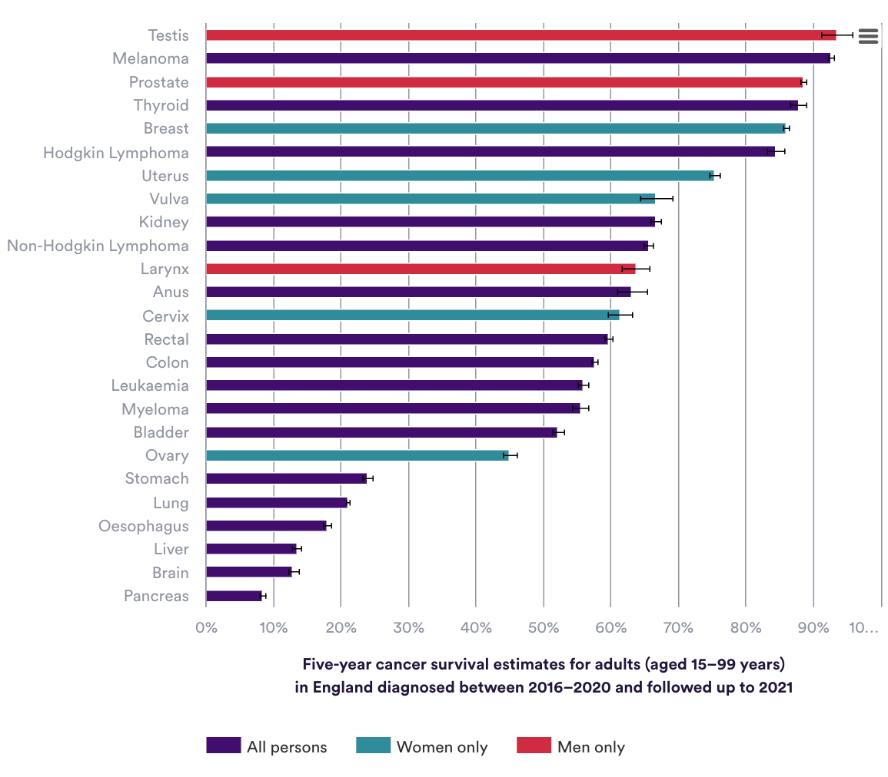
nuffieldtrust.org.uk

Slide 6
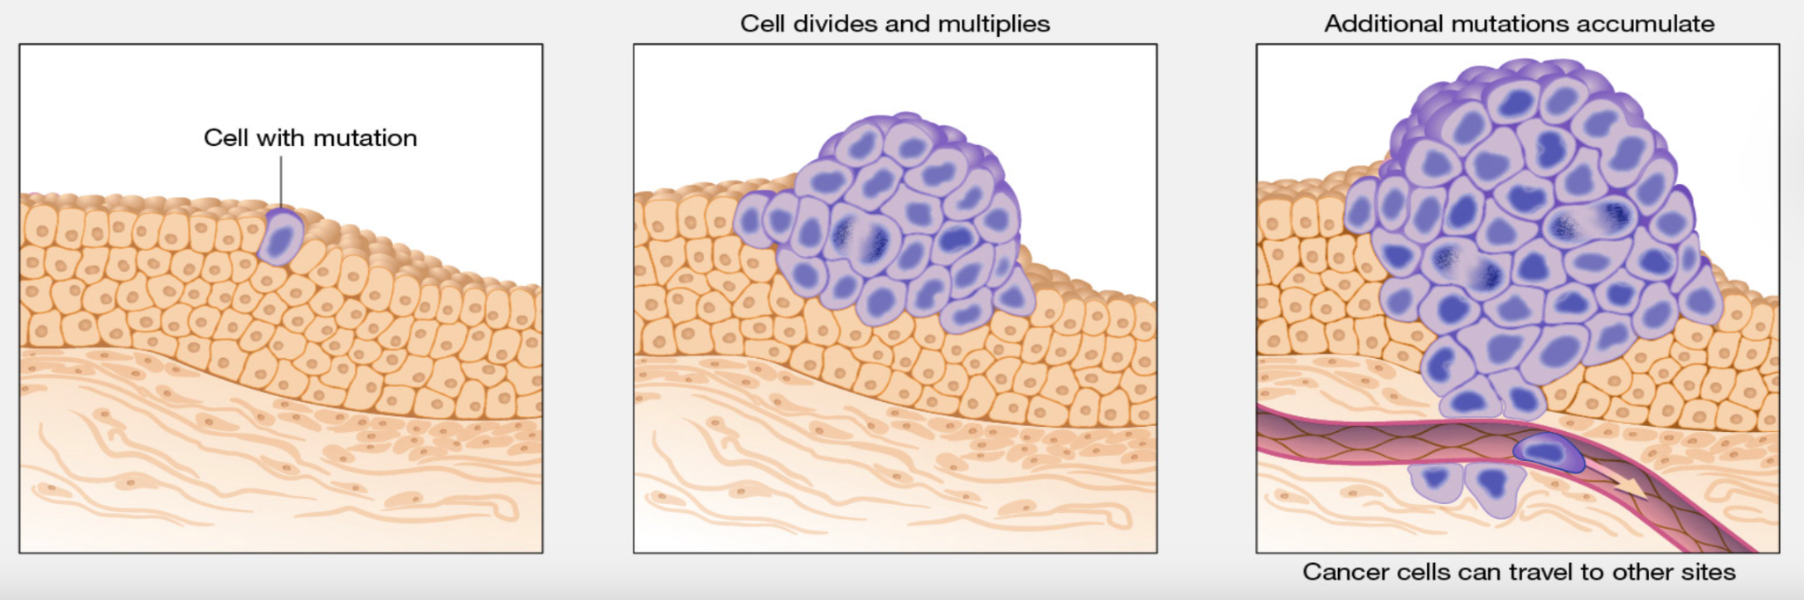
Cancer: uncontrolled cell growth/proliferation
Cancer | genome.gov

Slide 7
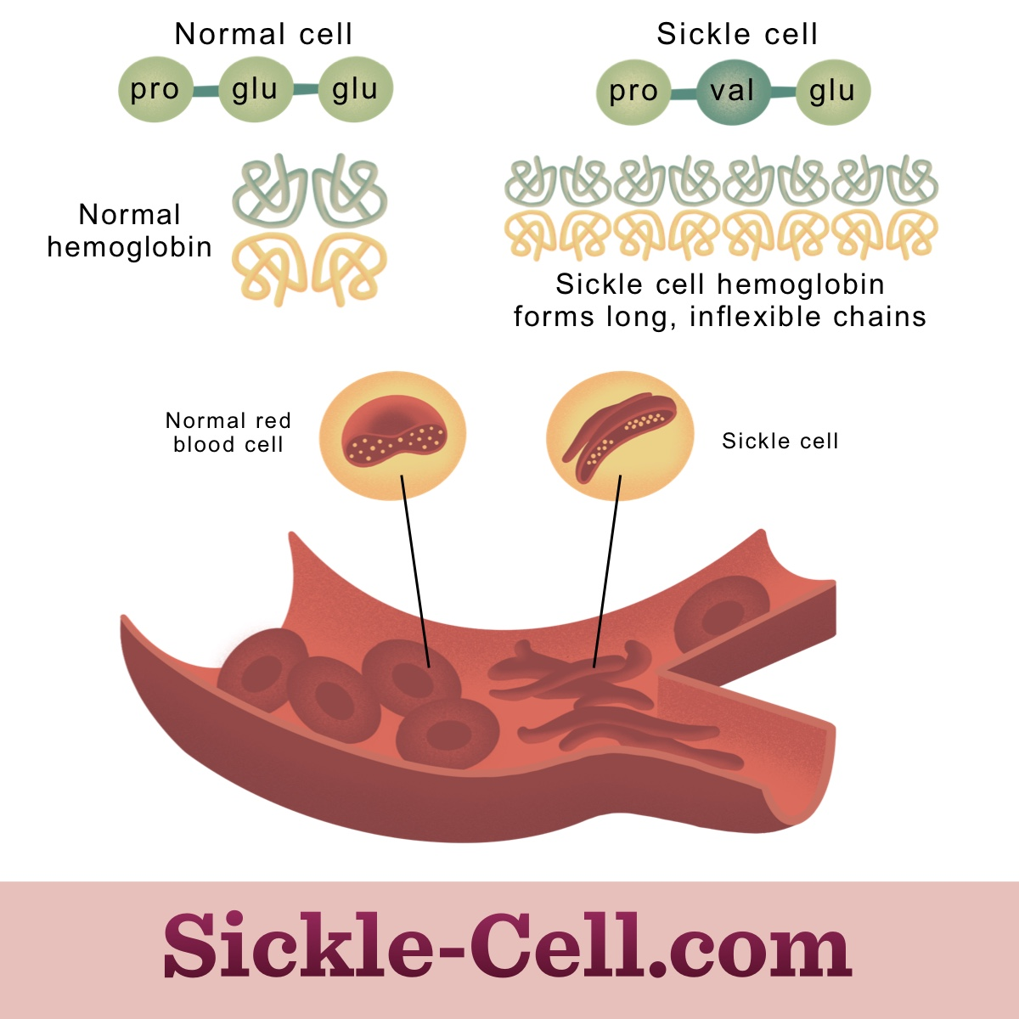
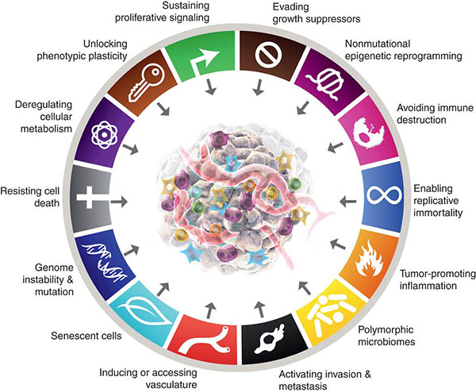
Mendelian Diseases vs Cancer
Hallmarks of Cancer
> Usually can be explained by a few genetic defects
> 7000 rare diseases are known
New Dimensions in Cancer Biology: Updated Hallmarks of Cancer Published - American Association for Cancer Research (AACR)
Notes:
Not easier to treat than cancer, but less complicated in terms of impaired mechanisms, easier to genetically diagnose
Genetic reasons are less localised (defects in a single gene usually explain the disease vs normal), more deterministic outcome (when you have the mutant protein, you are likely to have the disease)
https://interestingengineering.com/7-rare-diseases-that-can-now-be-treated
Marfan syndrome: https://www.msdmanuals.com/de-de/profi/pädiatrie/erkrankungen-der-knochen-und-bindegewebe-bei-kindern/marfan-syndrom

Slide 8
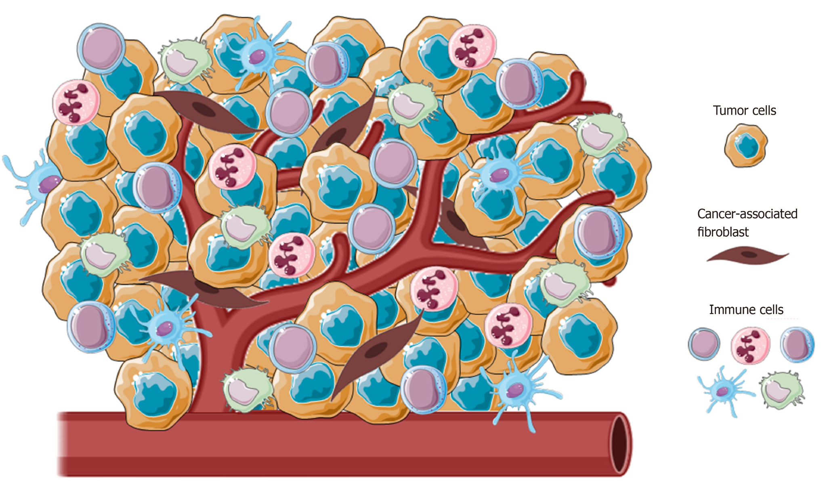
Tumor Microenvironment
Polidoro MA, et al, World J Gastroenterol 2020
Notes:
Cancer cells + normal cells (blood vessels) immune cells + microbiome
Intra-tumor heterogeneity
No two patients are the same

Slide 9
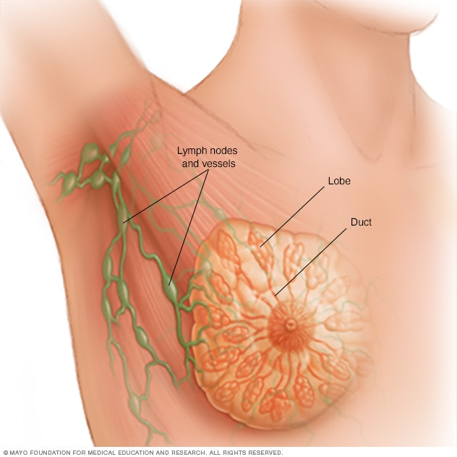
Current State of Cancer Diagnosis/Treatment
Principal clinical features to consider:
Age
Gender
Menopause status
Tumor stage
Principal genetic features to consider:
HER2, Estrogen receptor, Progesterone receptor (Hormone Therapy)
BRCA1/2 gene mutations (PARP inhibitors)
PD-L1 (Immunotherapy)
Multi-gene panels (Oncotype Dx, MammaPrint) => 50-70 genes (chemotherapy benefit)
mayoclinic.org
Notes:
https://www.verywellhealth.com/history-of-breast-cancer-5207255
https://www.cancer.org/cancer/breast-cancer/treatment.html
https://www.karger.com/Article/FullText/516788

Slide 10


Current State of Cancer Diagnosis/Treatment
Gene Panels to guide clinical decisions
> 350 genes
~ 700 genes
Mutations
Copy Number Alterations
Derivative features
Microsatellite Instability
Tumor Mutation Burden

Slide 11
Why do we need multi-omics integration?
Notes:
As argued up to this point, we need to make use of as many layers of omics as possible to understand better how to diagnose and treat different cancers.
No two patients have identical profiles
Different layers of omics data have different dimensions (e.g. 25000 for transcriptome, 450,000 for methylome, etc.) and each layer may have a unique range/distribution.
Curse of dimensionality: we have way too many features (on the order of 100s of thousands of features) compared to the number of observations (on the order or 100s to 1000s)

Slide 12
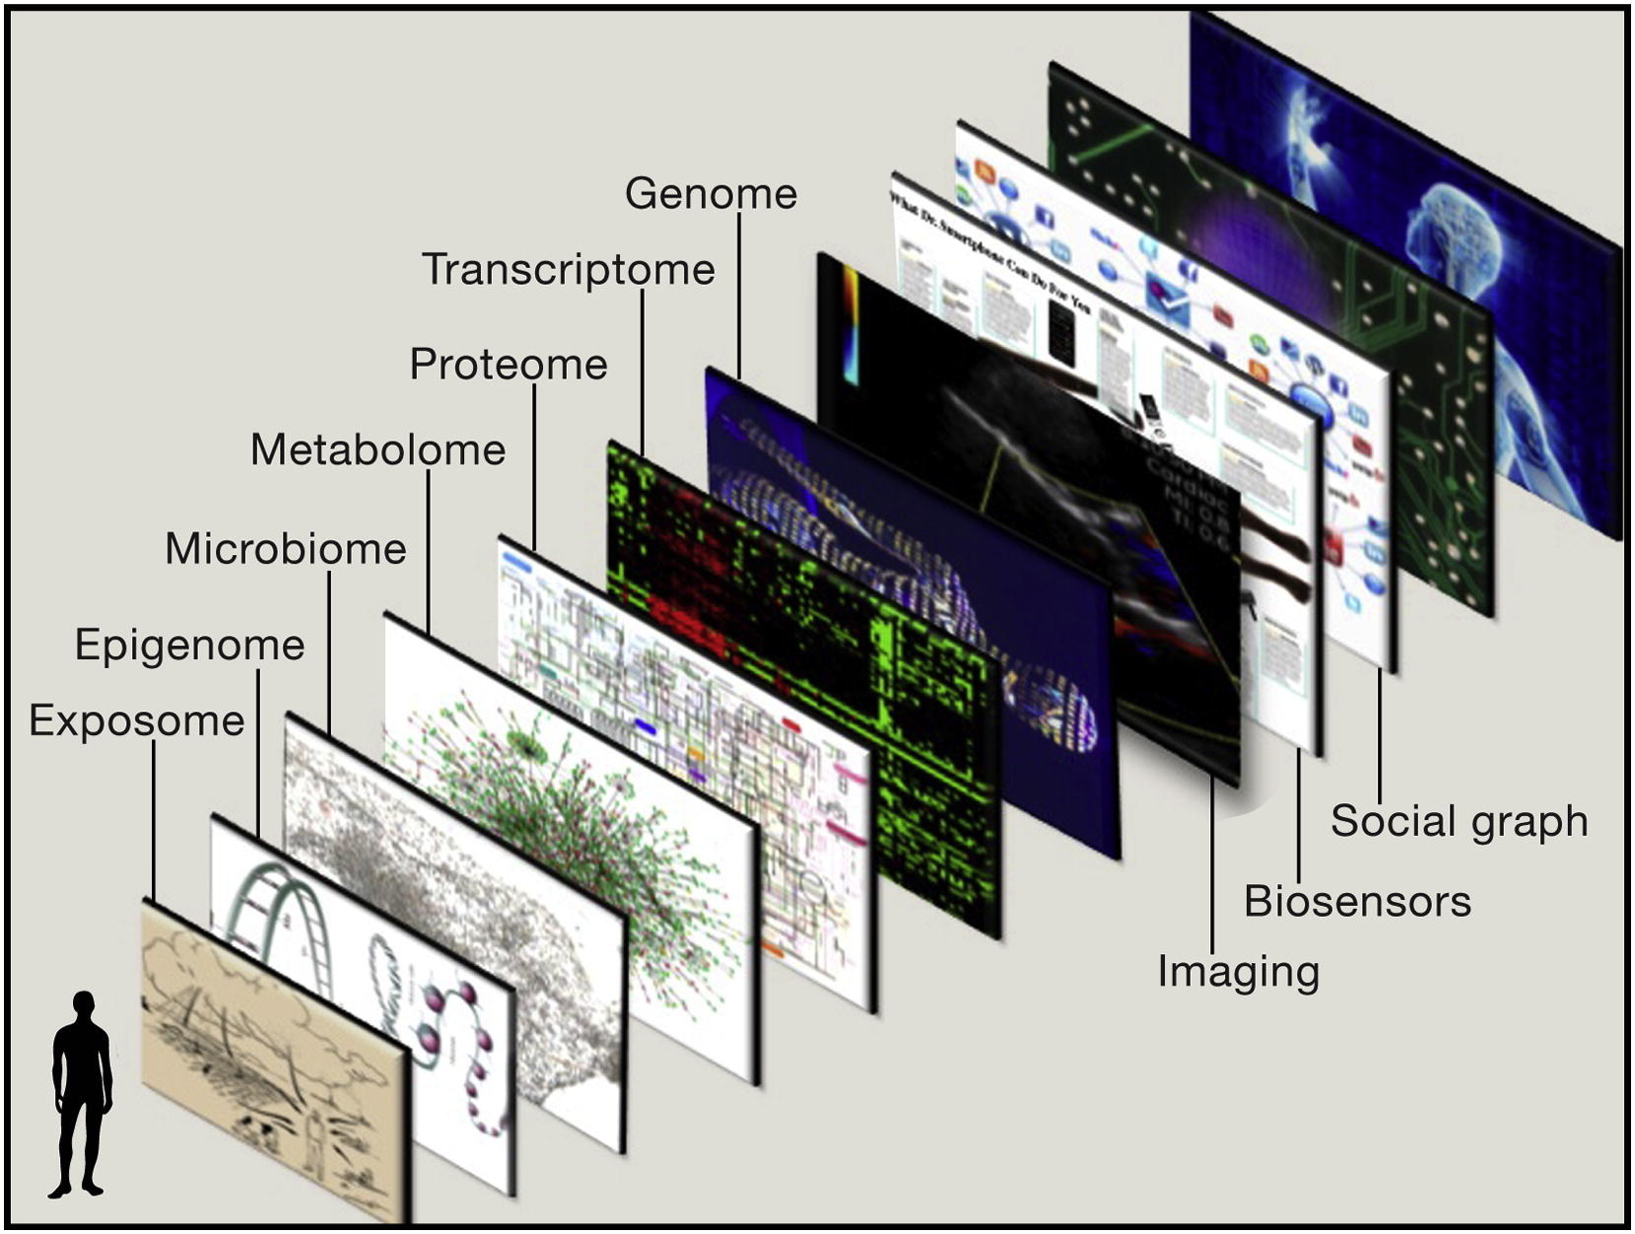
Topol, E., 2014, Cell
Notes:
Although these are great options to have, we are currently still focusing on only a single layer (the genome) and a small portion of it (a few to hundreds of genes out of ~25000 genes)

Slide 13
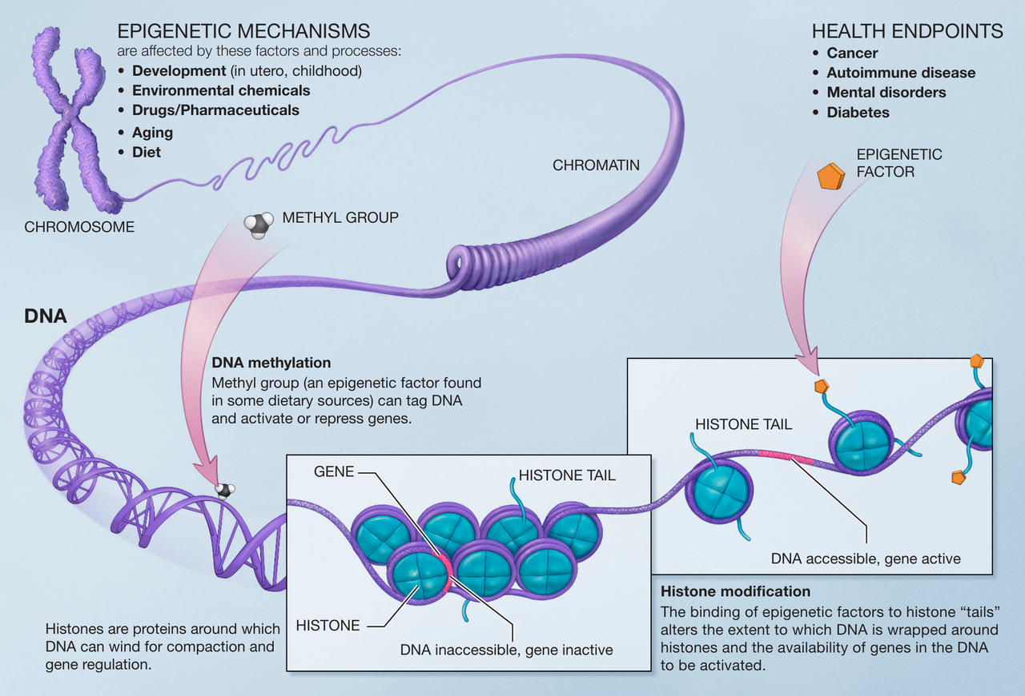
Epigenome
https://en.wikipedia.org/wiki/Epigenetics

Slide 14
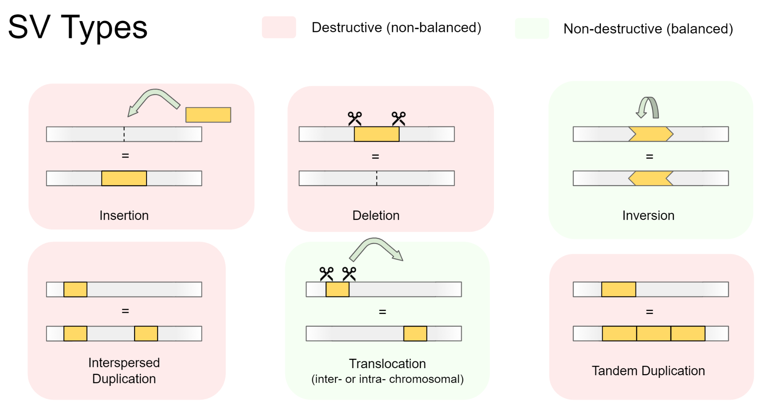
Genome: structural rearrangements
https://www.melbournebioinformatics.org.au/tutorials/tutorials/longread_sv_calling/longread_sv_calling/

Slide 15
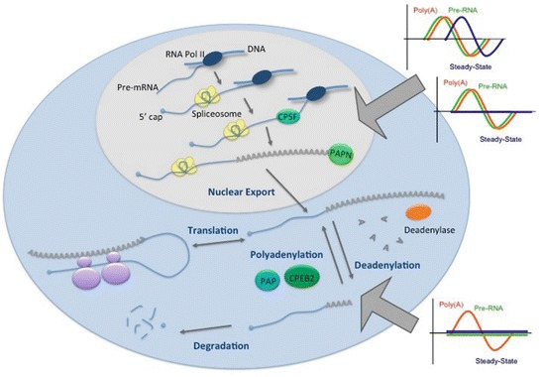
Transcriptome
https://www.ncbi.nlm.nih.gov/books/NBK453179/figure/ch5.Fig1/

Slide 16
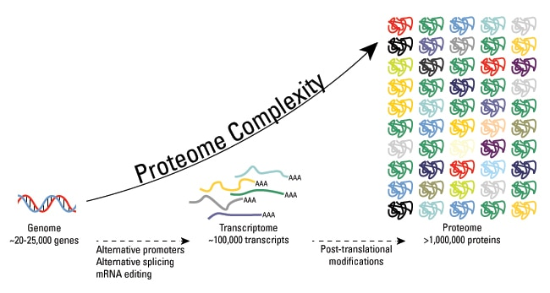
Proteome
https://www.thermofisher.com

Slide 17
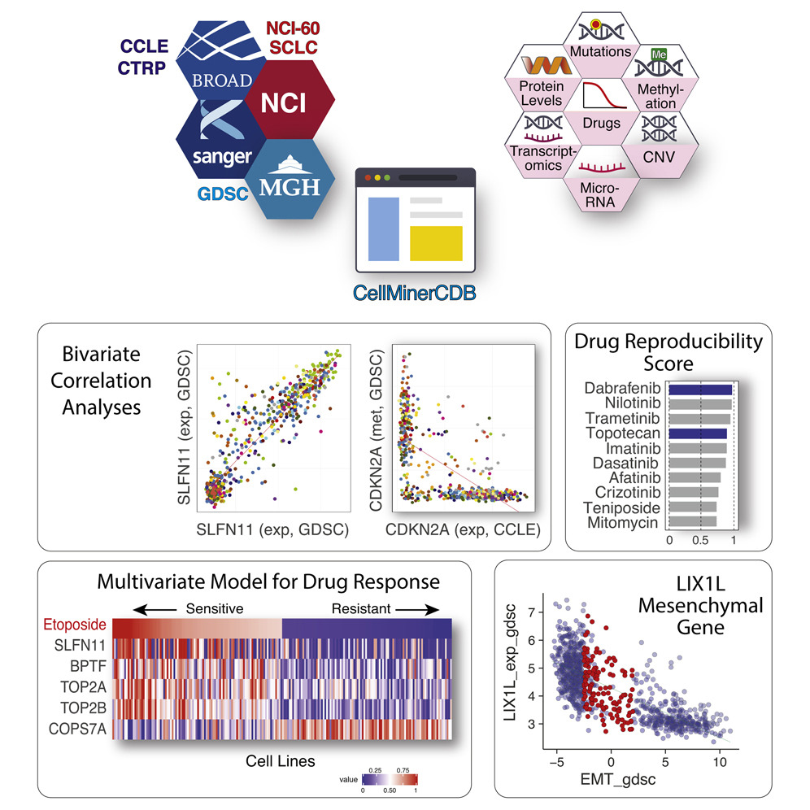
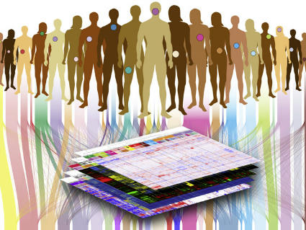
Where can I find multi-omics data for cancer?
TCGA: The Cancer Genome Atlas
33 cancer types, >11000 tumor samples, 7 omics types
Drug responses in cancer cell lines (CCLE/GDSC/NCI)

Slide 18
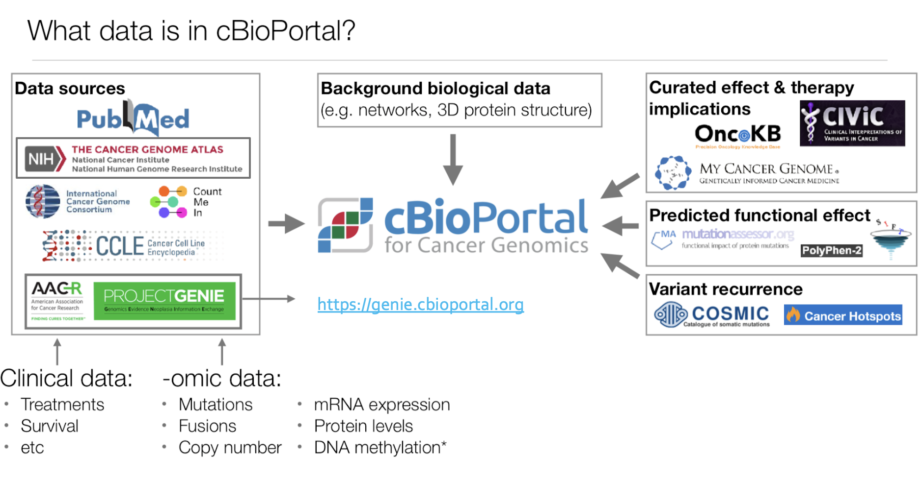
Where can I find multi-omics data for cancer?
https://zifornd.com/blogs/cbioportal/

Slide 19
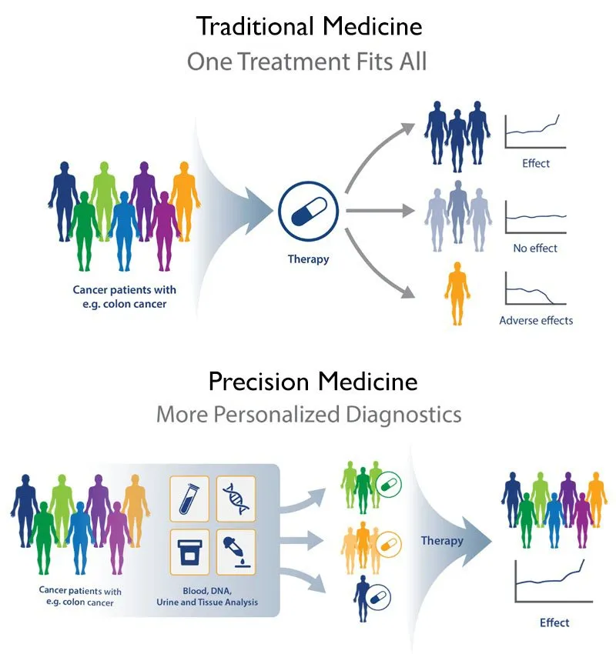
Precision Medicine
The Manhattan Center for Gynecology offers Precision Medicine

Slide 20
Patient stratification
Drug response: does the patient have the molecular profile that will most benefit from this drug?
Survival outcomes: how likely is this patient to have a disease recurrence?
Subtyping: what is the potential underlying molecular mechanism that led to this disease for this patient?
E.g. high mutation burden, structural aberrations, high expression of hormone receptors
Metastasis: how likely is a given tumor to metastasize to other organs?

Slide 21
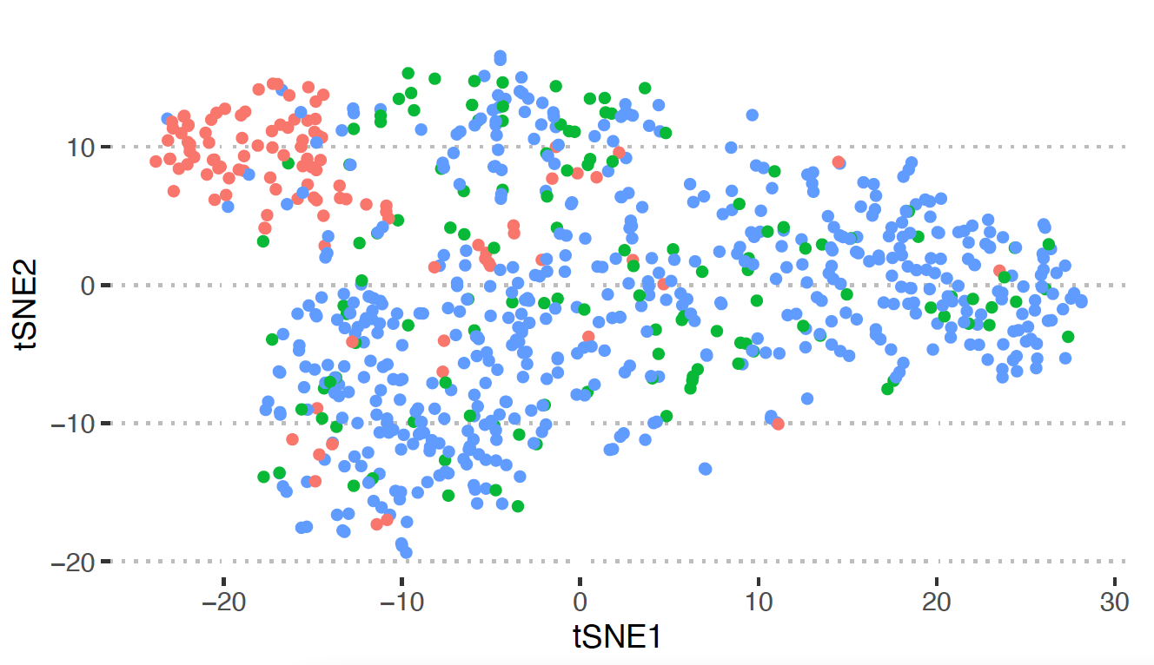
You
are here
Longest survivors past 10 years
Most likely to respond to treatment A
Most likely
metastasize
Most likely to respond to treatment B

Slide 22
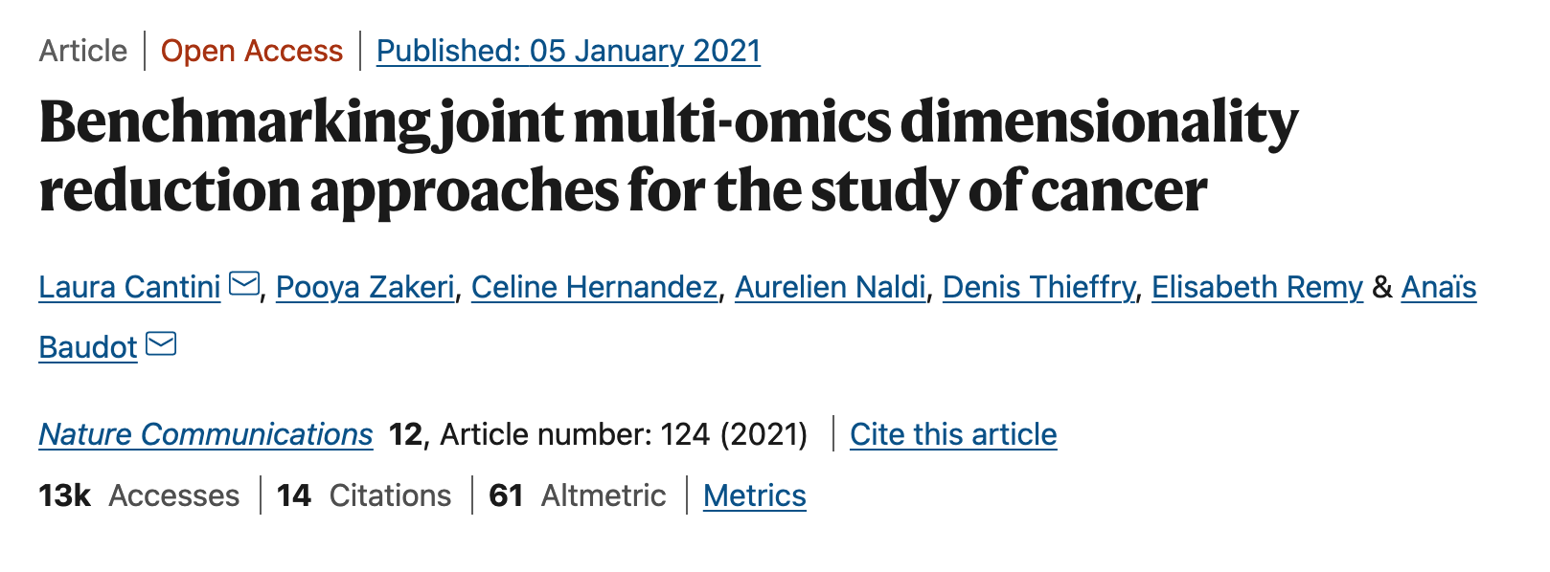
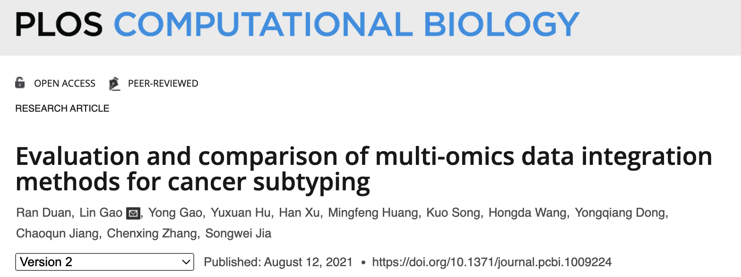
Multi-omics integration methods

Slide 23
Multi-omics integration methods (some examples)
Dimension Reduction with Clustering
Dimension Reduction
Clustering
MCIA
MOFA
JIVE
RGCCA
MAUI
intNMF
iclusterPlus
SNF
COCA

Slide 24
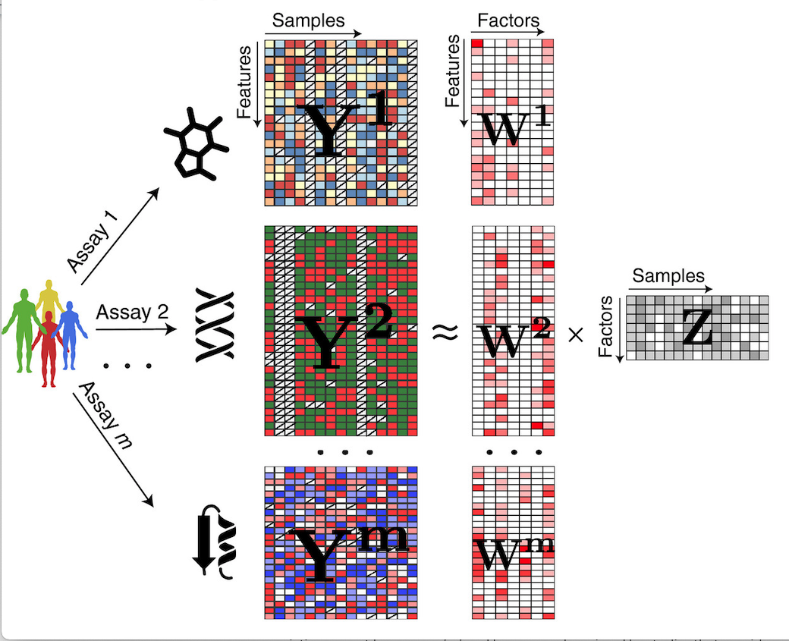
Joint Dimension Reduction and Integration
Latent Factors
Argelaguet et al, Mol Syst Biol, 2018 (MOFA)

Slide 25
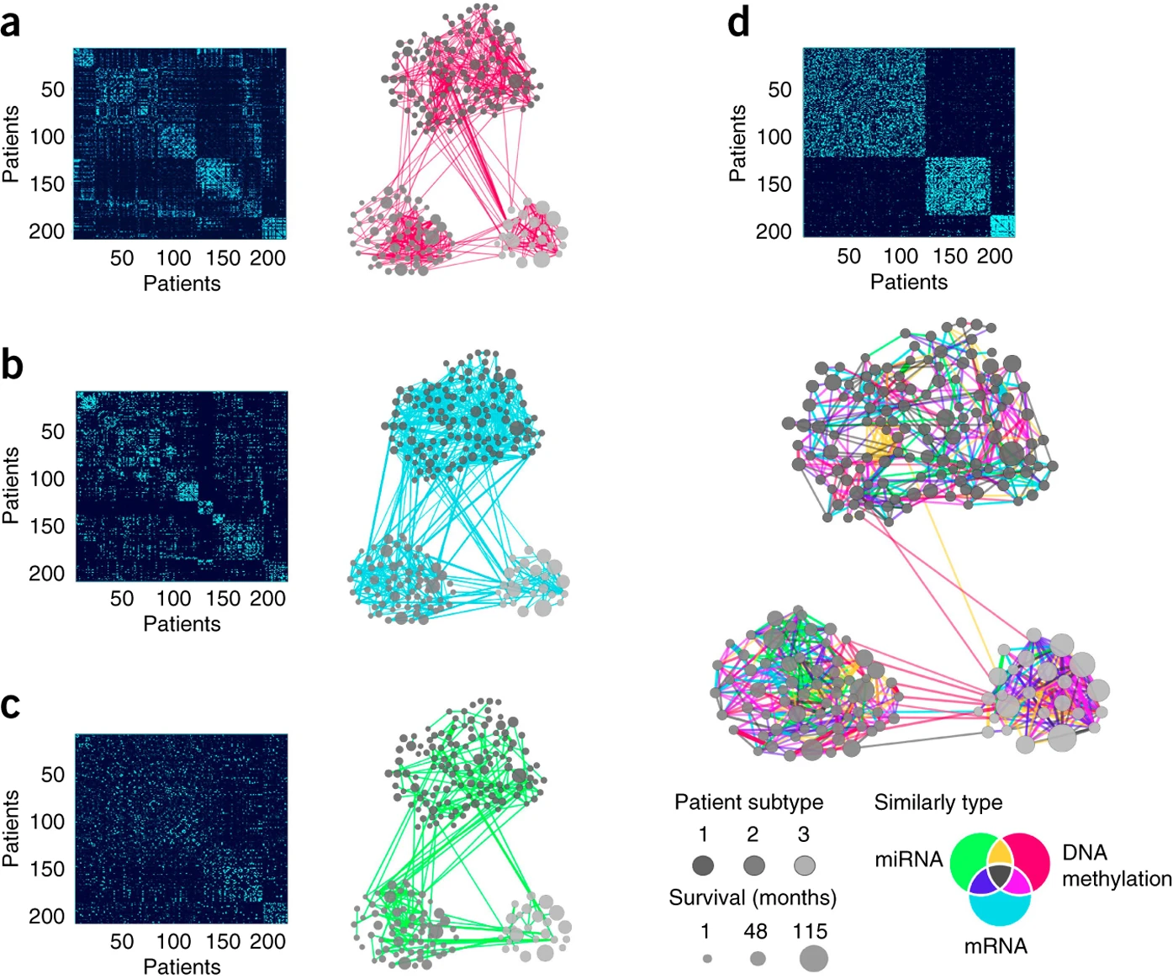
Similarity Network Fusion - Integrative Clustering
Wang, B. et al, Nat. Methods, 2014

Slide 26
Deep Learning Approaches

Slide 27
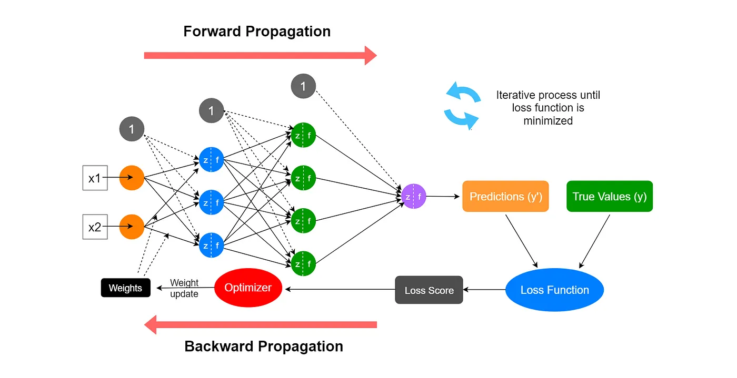
Neural Networks
Decoding Backpropagation and Its Role in Neural Network Learning | ml-articles – Weights & Biases

Slide 28
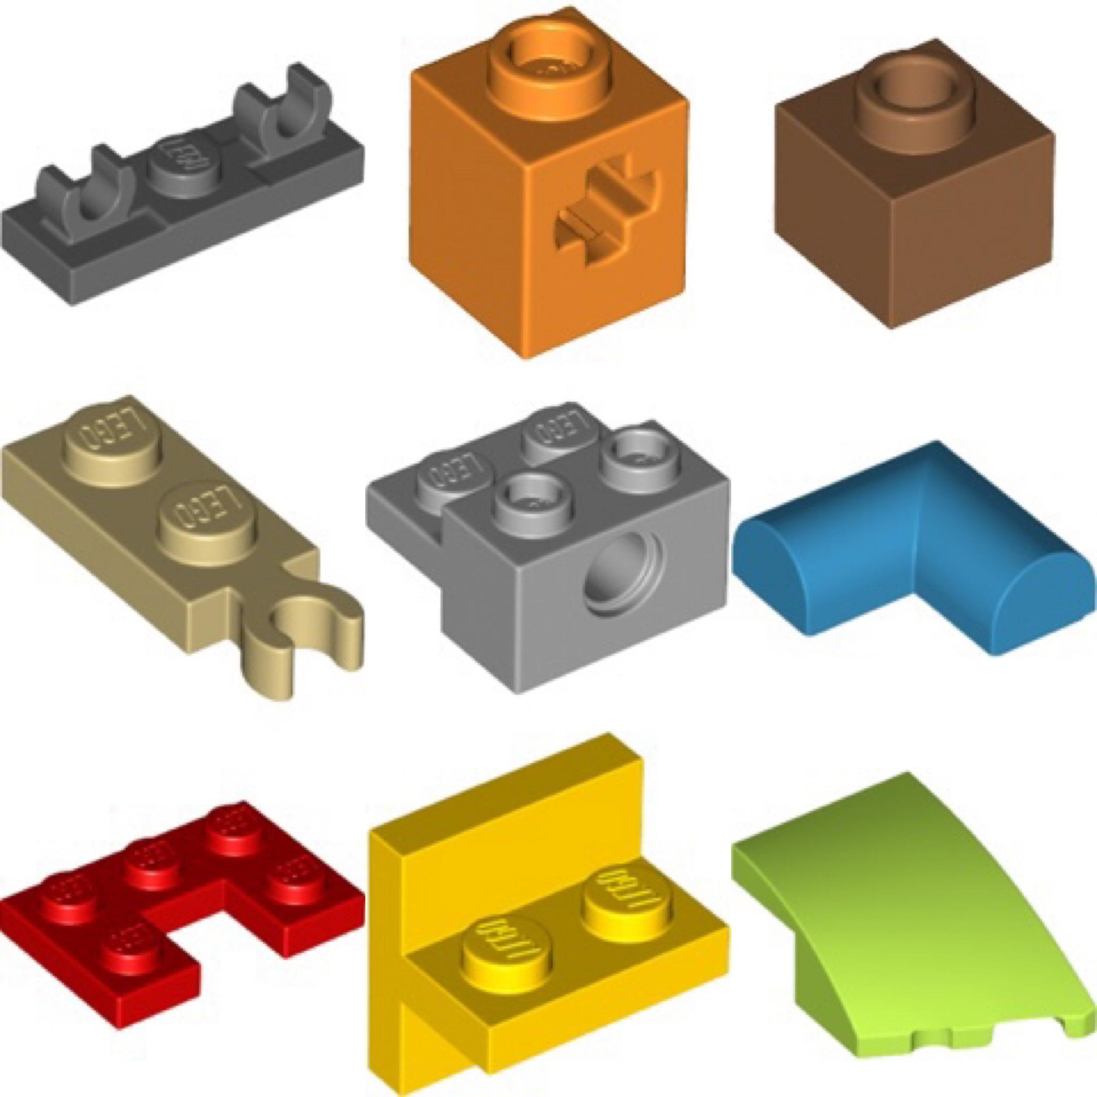
Neural Network Layers can be combined like Lego pieces

Slide 29
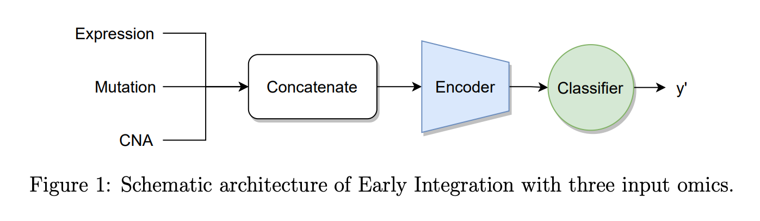
Different approaches for integrating omics layers using deep learning
Tony Hauptmann and Stefan Kramer, Arxiv, 2022
Simple Early Integration

Slide 30
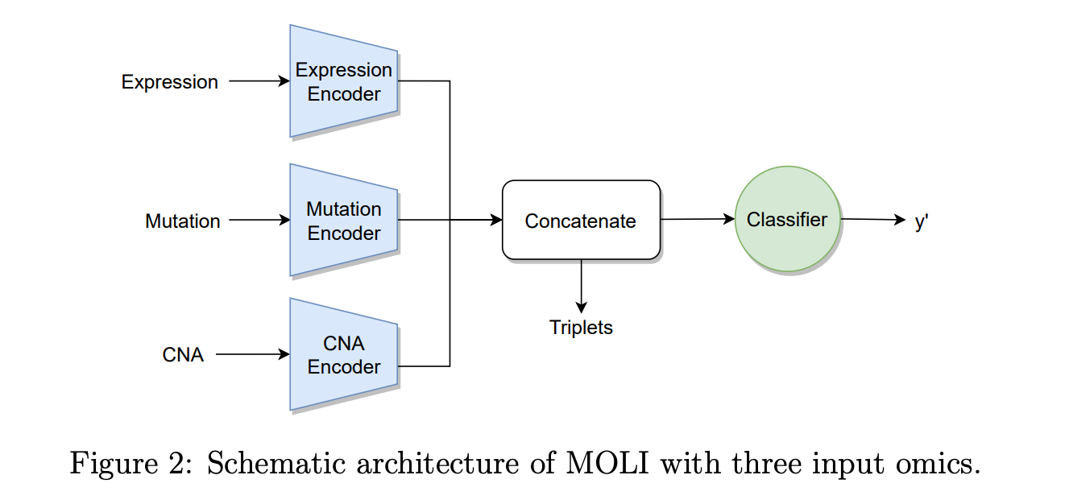
Different approaches for integrating omics layers using deep learning
Tony Hauptmann and Stefan Kramer, Arxiv, 2022
MOLI

Slide 31
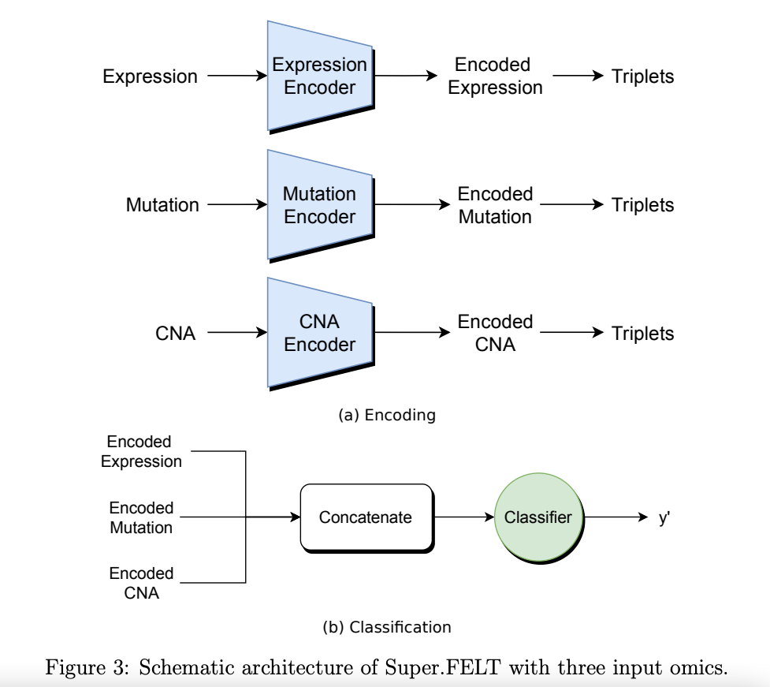
Different approaches for integrating omics layers using deep learning
Super.FELT
Tony Hauptmann and Stefan Kramer, Arxiv, 2022

Slide 32
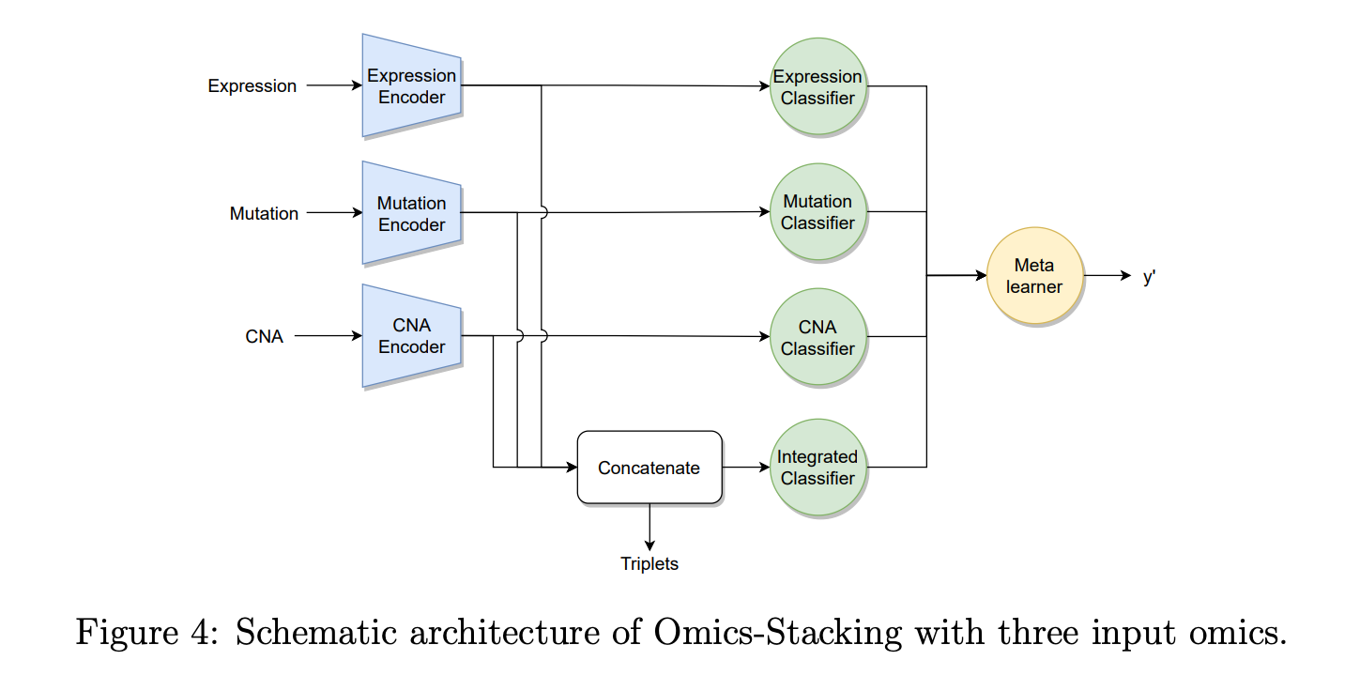
Different approaches for integrating omics layers using deep learning
Omics-Stacking
Tony Hauptmann and Stefan Kramer, Arxiv, 2022

Slide 33
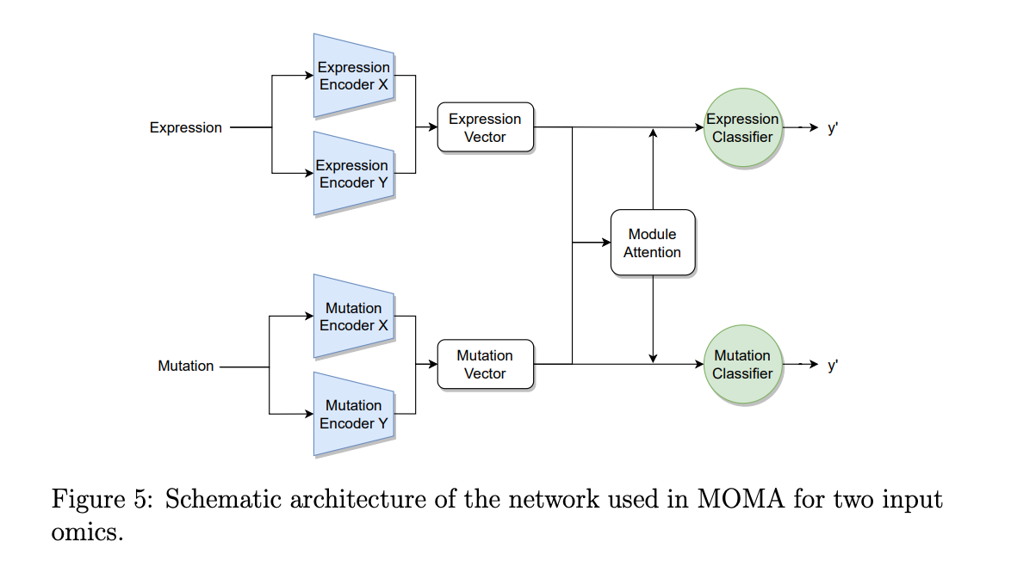
Different approaches for integrating omics layers using deep learning
MOMA
Tony Hauptmann and Stefan Kramer, Arxiv, 2022

Slide 34
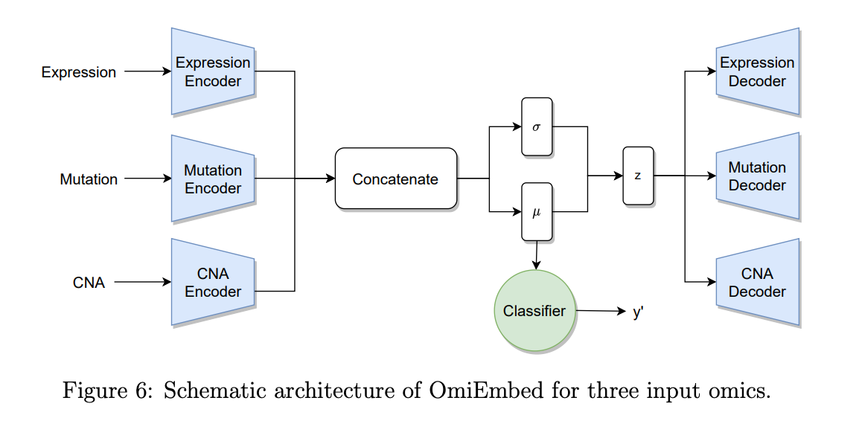
Different approaches for integrating omics layers using deep learning
OmiEmbed
Tony Hauptmann and Stefan Kramer, Arxiv, 2022

Slide 35
Conclusions from Some Benchmarking Papers
Benchmark by Tony Hauptmann and Stefan Kramer, Arxiv, 2022
Compared 6 Tools: Simple Early Integration Classifier, Super.FELT, MOLI, Omics-Stacking, OmiEmbed, MOMA
Early integration performed significantly worse
No method clearly outperforms others
Tools using triplet loss perform better than those that don’t
Omiembed (supervised VAE) performed worst on holdout data

Slide 36
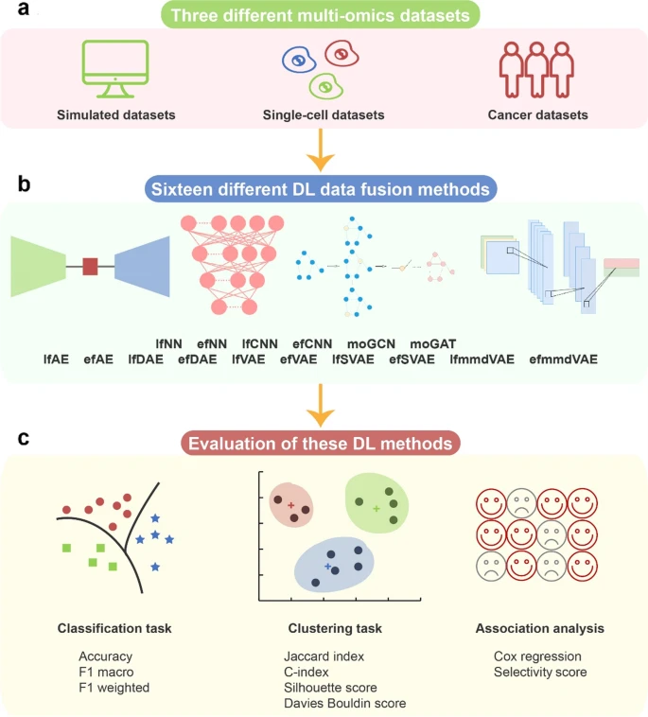
They test:
Integration sequence (early/late fusion)
Encoding
FCN
Autoencoders
Basic
Variational
Loss function (MMD vs KL for autoencoders)
Convolutions
Graph attention network
Graph convolution network
1D CNN
A benchmark study of deep learning-based multi-omics data fusion methods for cancer | Genome Biology | Full Text

Slide 37
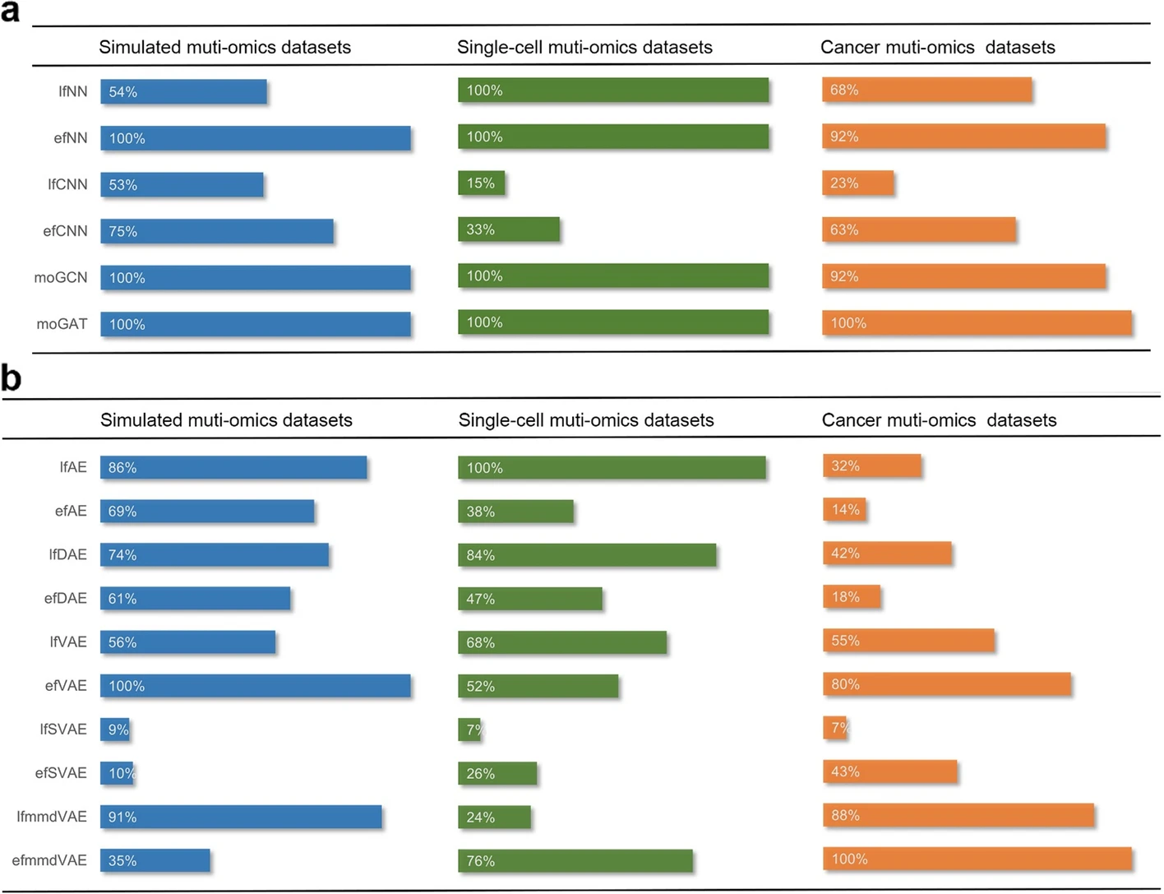
Summary:
No approach is the best in all scenarios
Overall Graph Attention Network performs better for classification
CNNs don’t work well
A benchmark study of deep learning-based multi-omics data fusion methods for cancer | Genome Biology | Full Text

Slide 38
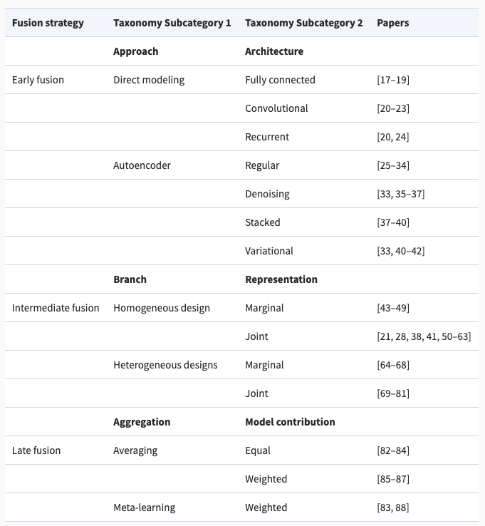
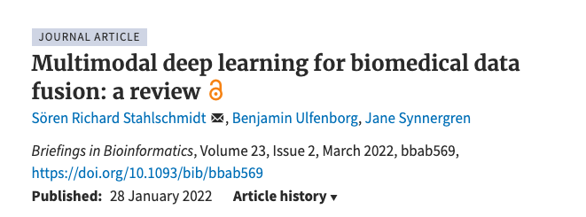
https://academic.oup.com/bib/article/23/2/bbab569/6516346?login=true
> 70 Deep Learning Multi-Omics Papers!
Notes:
Statistics about these papers: need to go through 70 papers (Tool available? Task?)

Slide 39
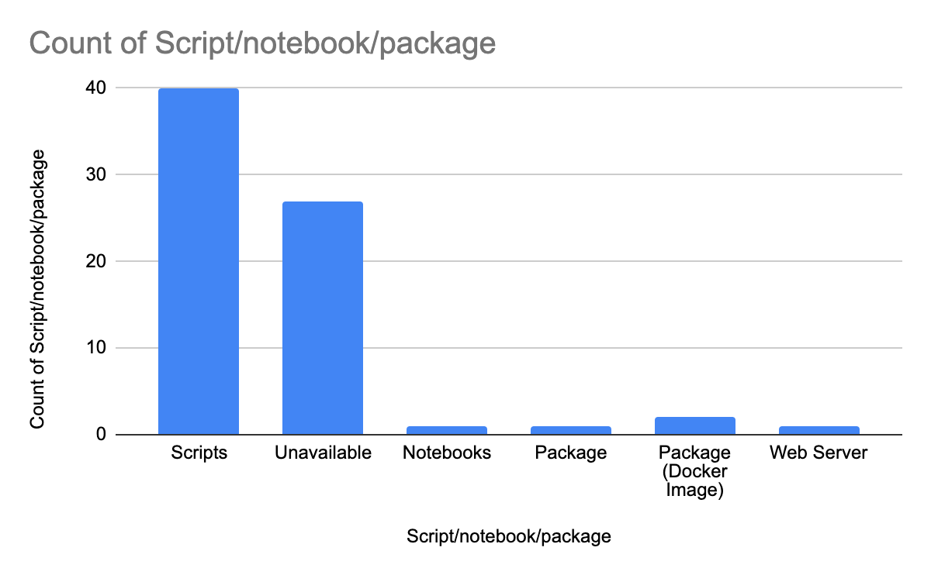
Literature Search Summary
MultiOmics Integration Tools (Deep Learning Based)

Slide 40
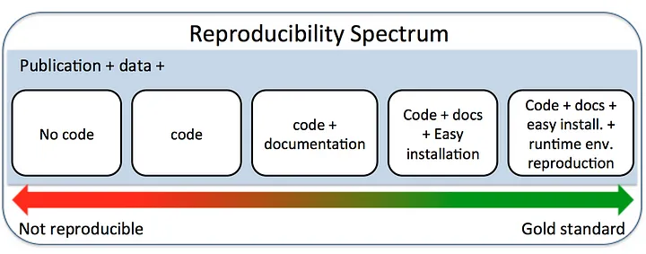
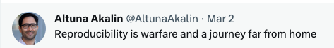

Slide 41
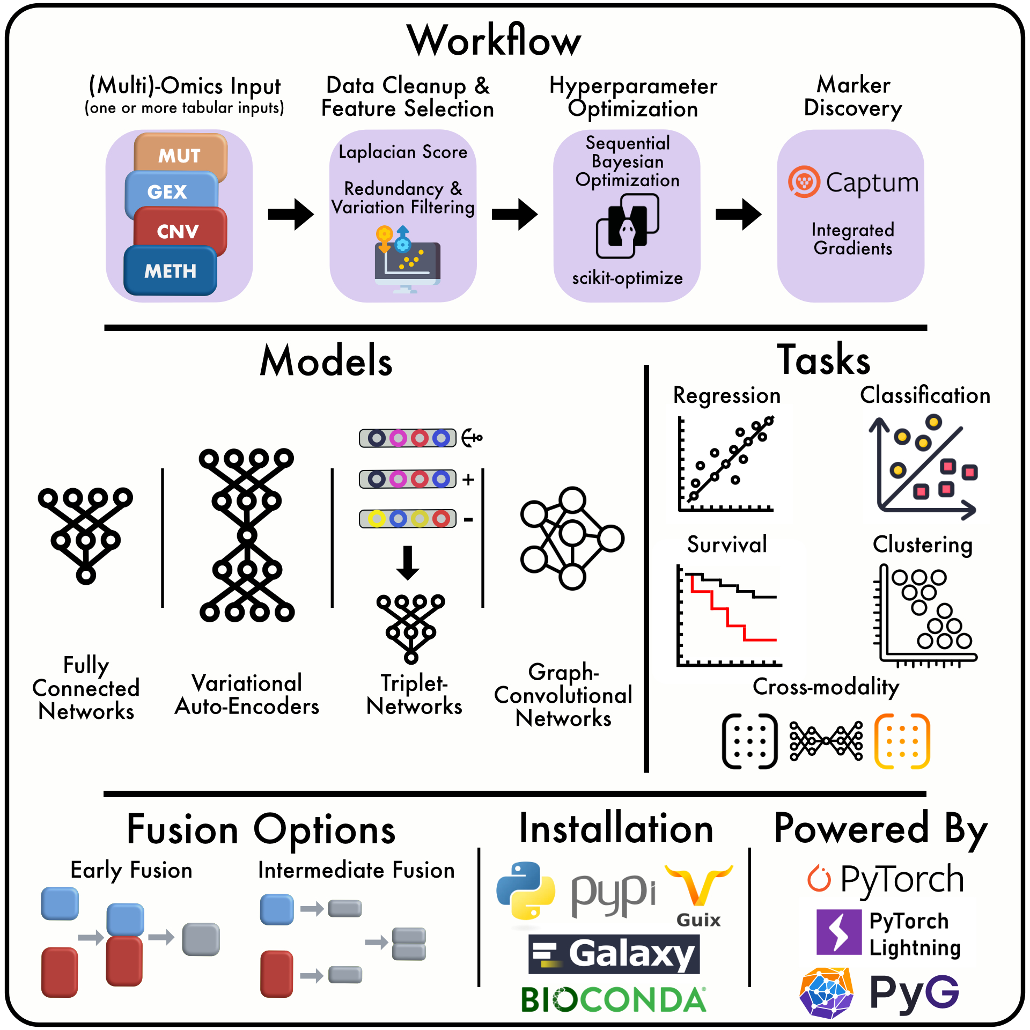
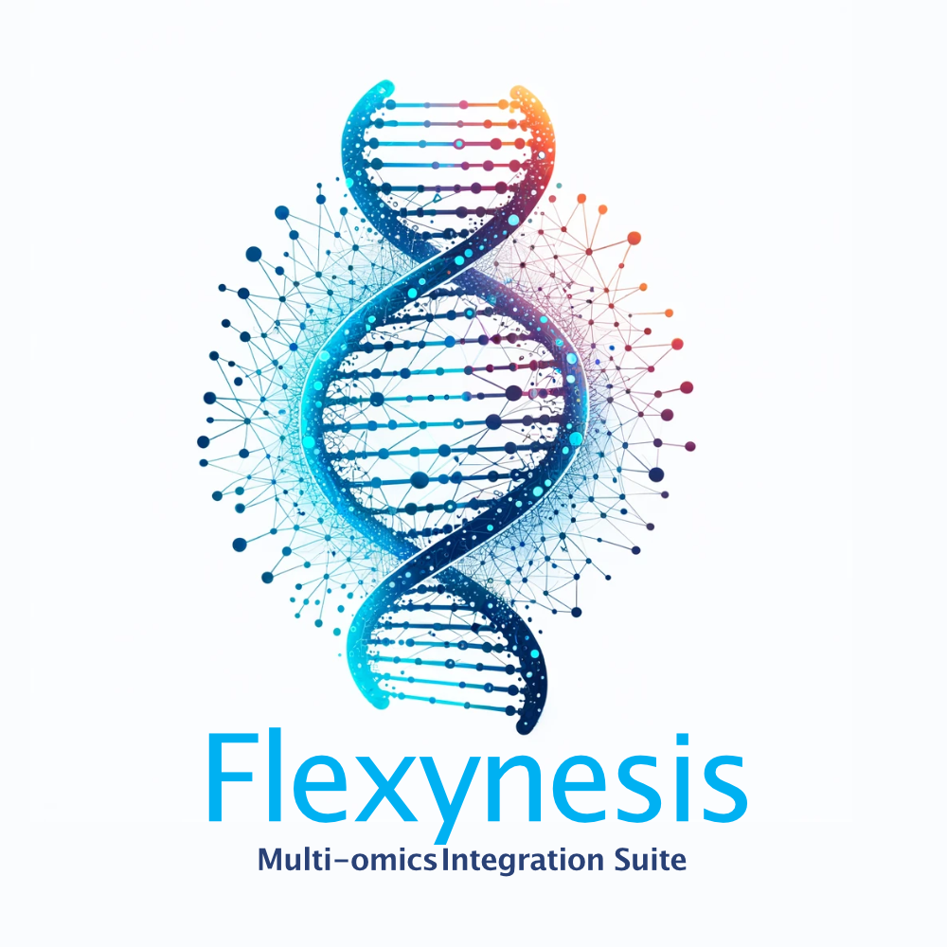
https://github.com/BIMSBbioinfo/flexynesis
Notes:
https://github.com/BIMSBbioinfo/flexynesis
Built using pytorch + pytorch-lightning
1. Data processing (removal of uninformative features, missing value imputation, transformation, normalisation). Data processing metrics are learned from training data and test/holdout data is transformed accordingly.
2. Train/validation/test structure is enforced. Models are evaluated on holdout datasets using multiple metrics
3. Unsupervised feature selection (a combination of laplacian score with redundancy removal)
4. Omics layer fusion options (early or intermediate). The user can provide one or more layers of omics data.
5. Hyperparameter optimisation using scikit-optimize bayesian optimisation
6. 3 main architecture options are available (fully connected network, variation autoencoder (with MMD loss), multi-triplet network). Every network allows one or more target variables and zero or more batch variables.
7. For every variable, a simple feed-forward network is connected to the core network. The user can provide as many variables as they want. Variables with missing values are allowed.
8. For the best model selected after the hyper-parameter optimisation procedure, feature importance values are computed using Captum IntegratedGradients method.
9. Each model has a standard input interface, which accepts a multiomics dataset (consisting of a list of data matrices and clinical variables table), a configuration for hyperparameters, a list of target variables and an optional list of batch variables. All methods have the same standard methods for training, predicting, and extracting sample embeddings.
10. Currently, regression and classification tasks are supported. The type of task is determined on-the-fly based on the variable type.
11. The software is packaged with pypi, conda, and guix. The tool can be run from the command-line interface with all the possible configurations described above, thus very easy to be integrated into a pipeline, thus many combinations of configurations can be tested (see the slide about continuous benchmarking)

Slide 42
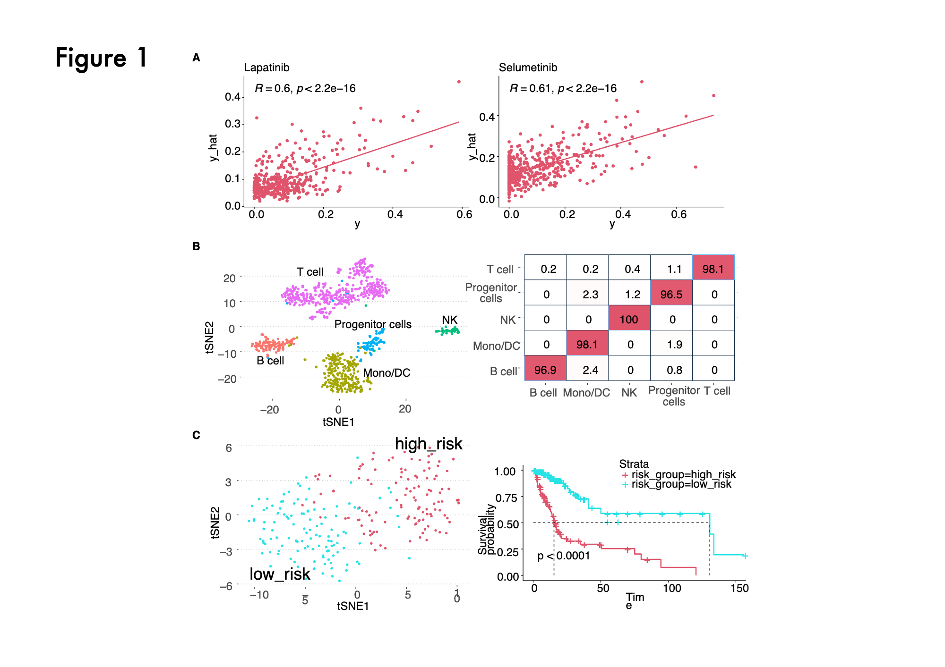

Slide 43
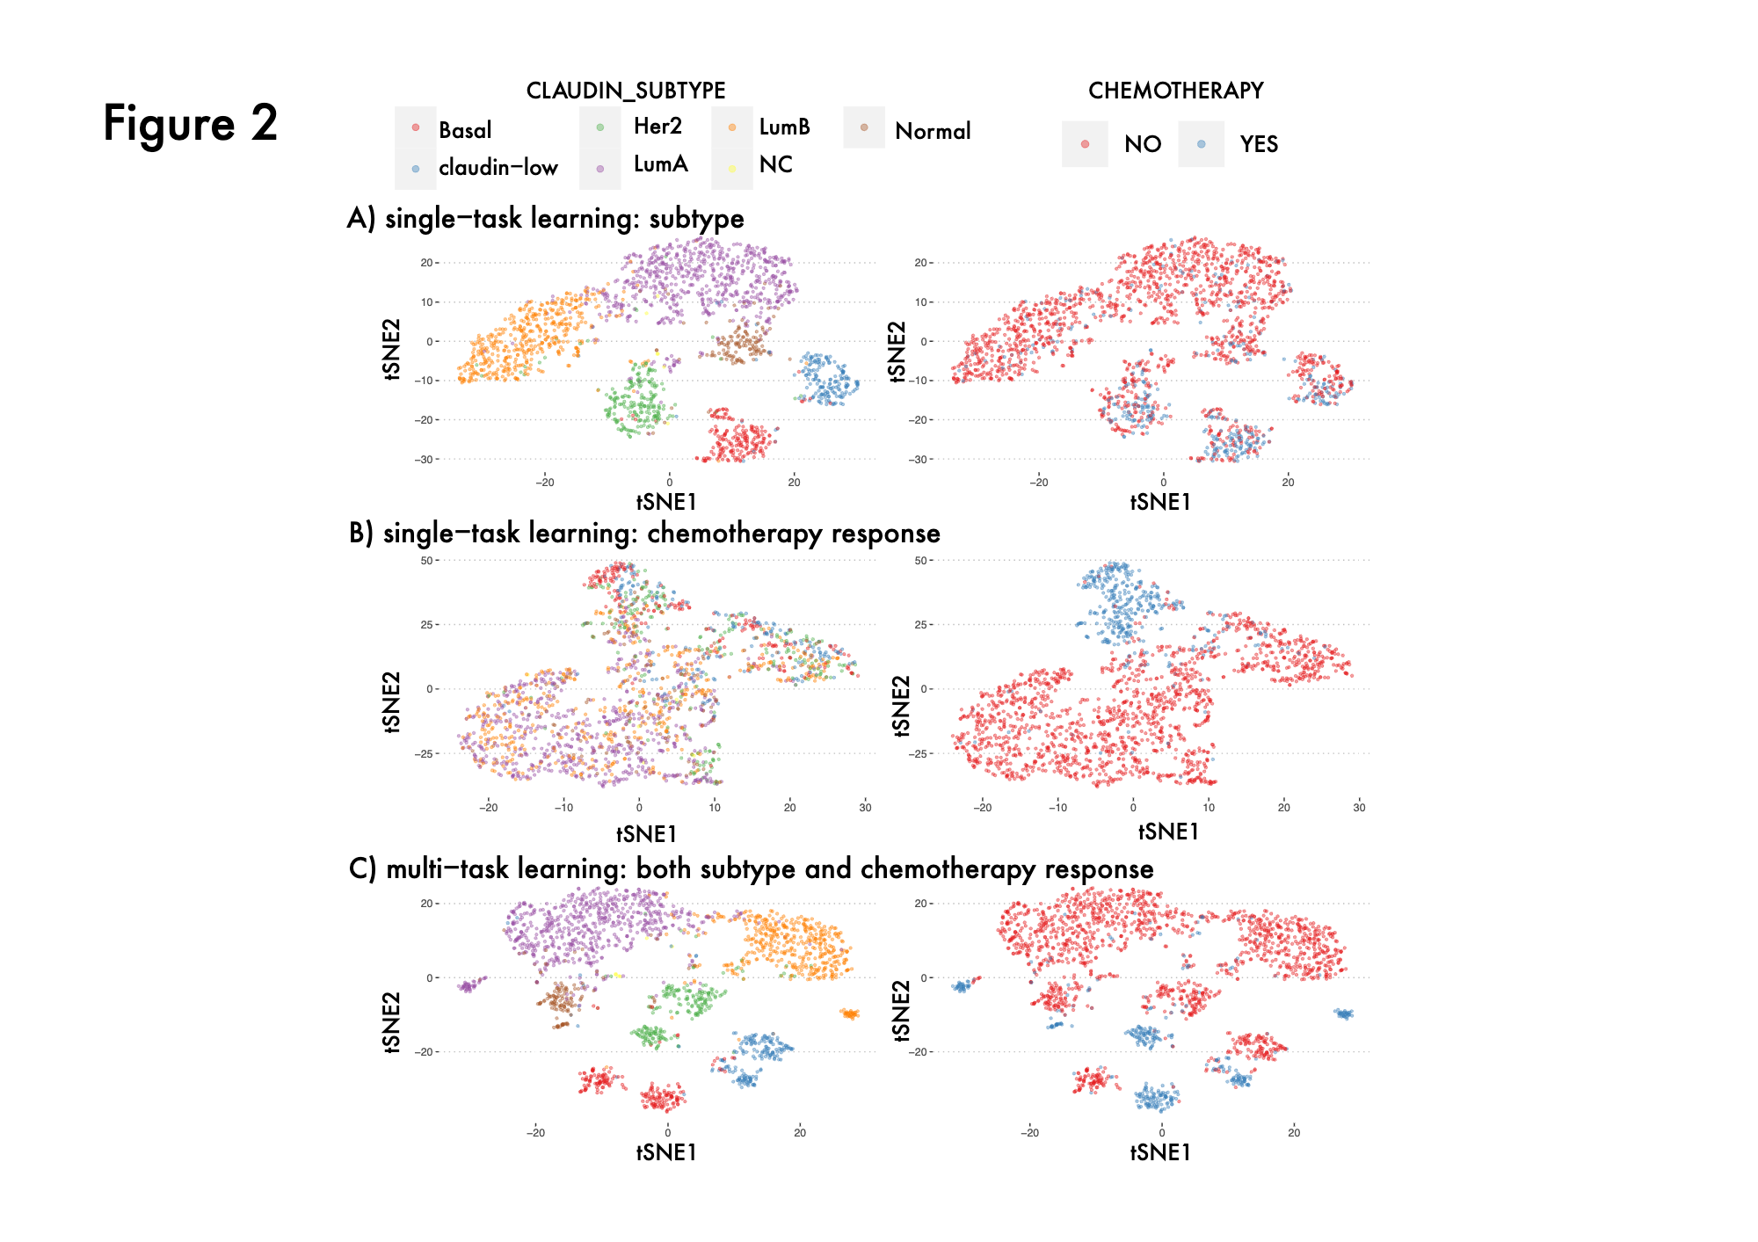

Slide 44
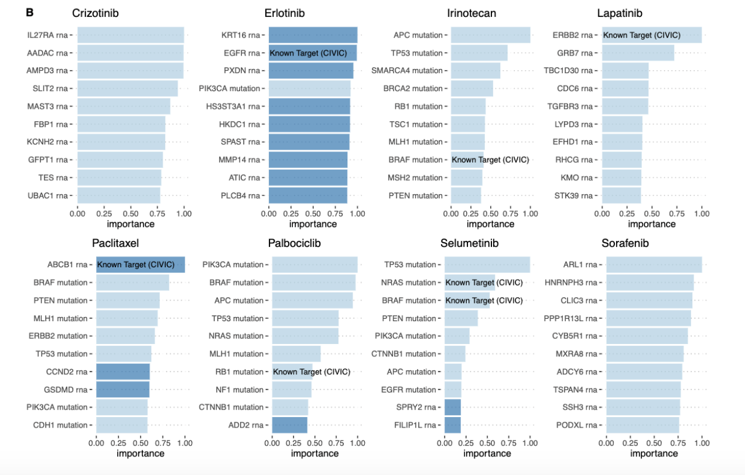

Slide 45
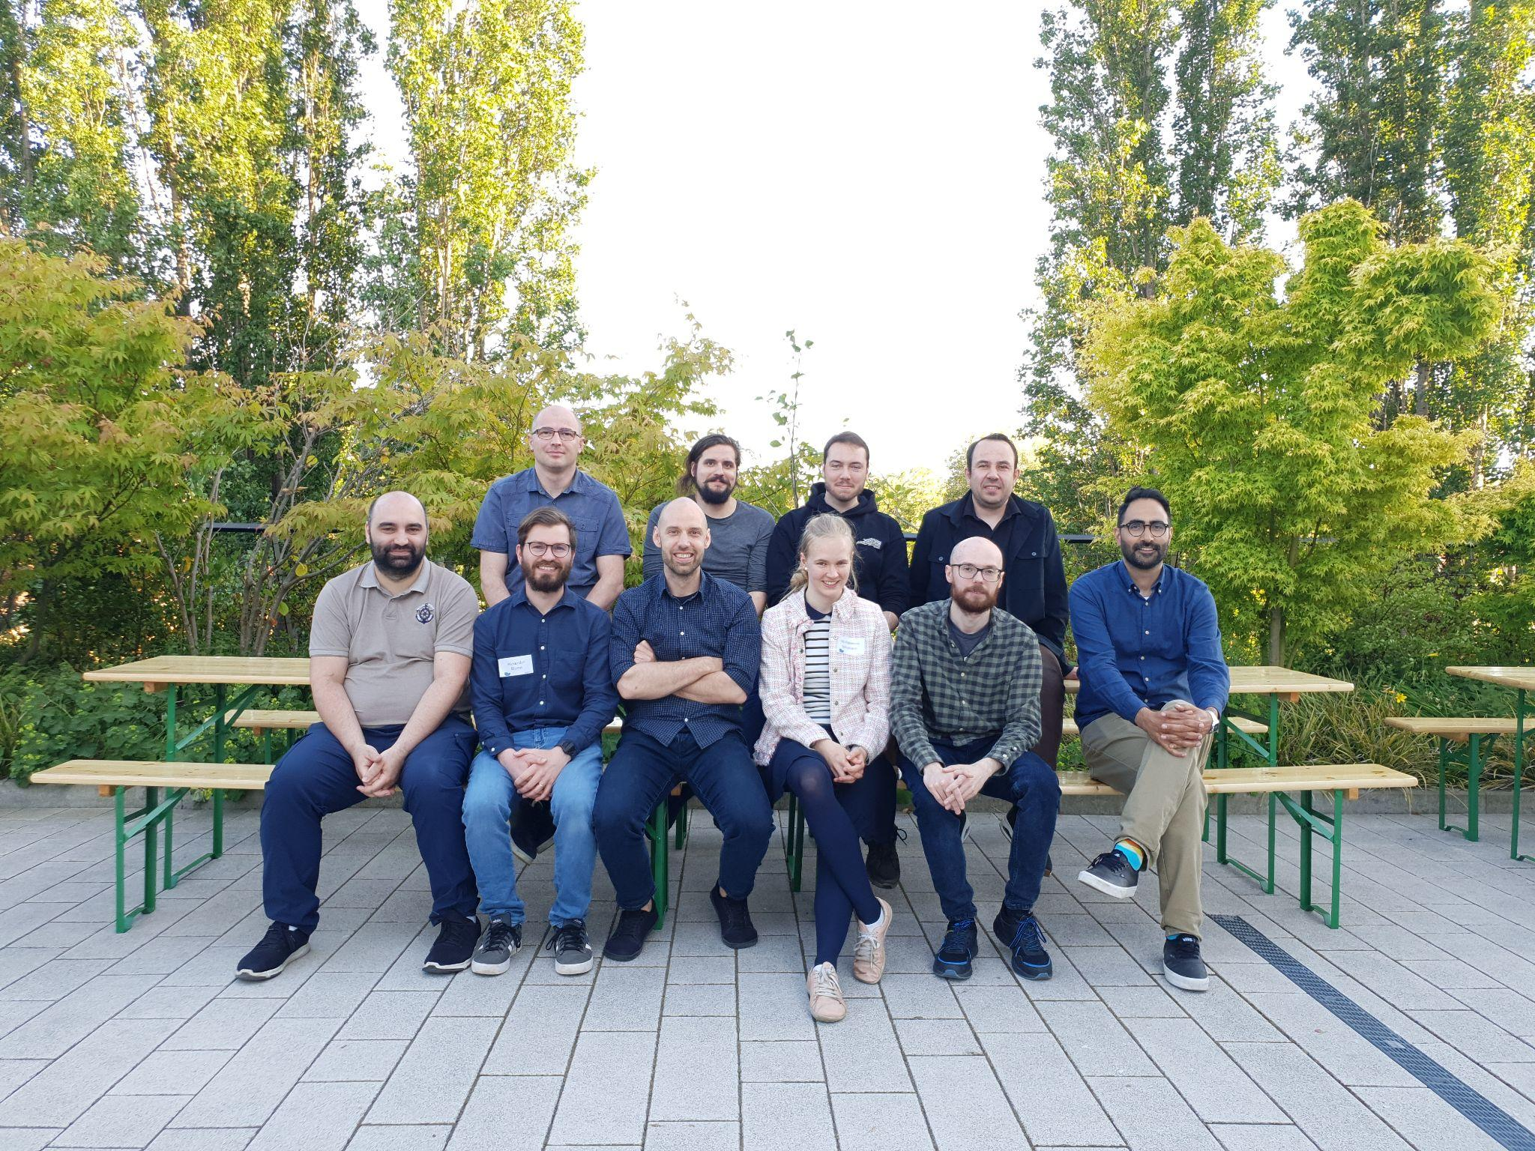
Acknowledgements
Akalin Lab Members

Slide 46
Day 1 - Homework
System Setup
Rolv.io / Docker / Mamba
See https://github.com/BIMSBbioinfo/compgen_course_2025_module3/blob/main/README.rst#compute-environment
See https://github.com/BIMSBbioinfo/compgen_course_2025_module3/tree/main/homeworks/hw1

Slide 47
Getting Help
https://github.com/BIMSBbioinfo/compgen_course_2025_module3/discussions

Slide 48
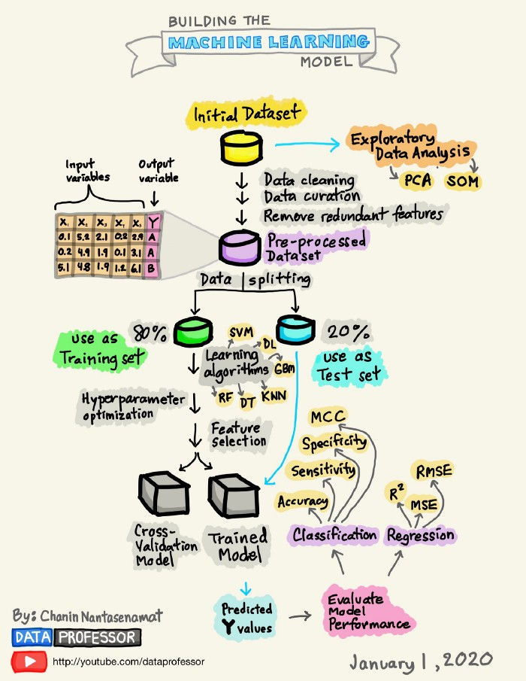
How to Build a Machine Learning Model | by Chanin Nantasenamat | Towards Data Science

